Slide 1
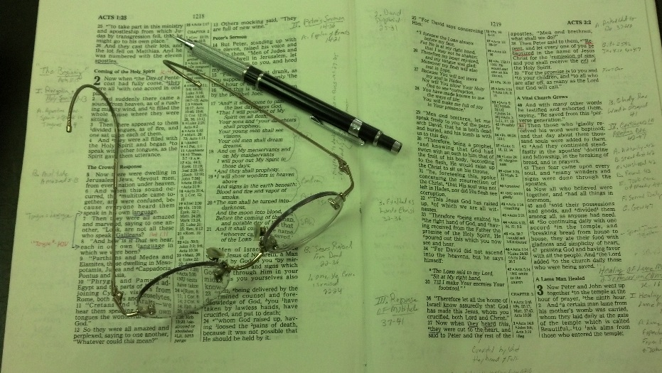
Topics
Thursday: Settled in Complacency
Friday: The Earnest Cry of Bartimaeus

Slide 2
Philippians 4:6–7
⁶ Be anxious for nothing, but in everything by prayer and supplication, with thanksgiving, let your requests be made known to God;
⁷ and the peace of God, which surpasses all understanding, will guard your hearts and minds through Christ Jesus.
There is “peace” that is not of God
Do you have the “peace of God”?

Slide 3
The Peace of God
The Peace of God
Phil. 4:7

Slide 4
The Peace of God
The Peace of God
What is the Peace of God?

Slide 5
What is the Peace of God?
The Meaning
BDAG: “a state of concord, peace, harmony…a state of well-being, peace.”
Lexham Theological Workbook: “The state of well-being and concord”
Louw-Nida: “a set of favorable circumstances involving peace and tranquility… The meaning of ‘peace’ or ‘tranquility’ may be expressed in some languages in a negative form, for example, ‘to be without trouble’ or ‘to have no worries’ or ‘to sit down in one’s heart.’”
Acts 24:2 (“peace” – NKJV, ESV; “quietness” - KJV)

Slide 6
What is the Peace of God?
The Meaning
How it is Used
Peace with God (Rom 5:1)
Peace with man (Mark 9:50)
Peace within self (Phil. 4:6-7)

Slide 7
What is the Peace of God?
The Meaning
How it is Used
Not like the Peace of the World (John 14:27)

Slide 8
The Peace of God
The Peace of God
What is the Peace of God?
Those Who Have the Peace of God

Slide 9
Those Who Have the Peace of God
The Source of Peace - Christ
Isa. 9:6-7 – prince of peace
Luke 1:79 – Christ came to guide us in peace
John 20:19, 21 – Jesus pronounced peace to disciples
Acts 10:36 – preaching peace through Christ
Thus, those who follow Christ have peace

Slide 10
Those Who Have the Peace of God
The Source of Peace – Christ
The Righteous
Psa. 29:11 – Lord blesses his people with peace
Psa. 37:11 – Meek shall have an abundance of peace
Psa. 37:37 – Blameless and upright – have peace
Rom. 8:6 – Spiritually minded have peace
Gal. 5:22 – Those who follow the Spirit

Slide 11
The Peace of God
The Peace of God
What is the Peace of God?
Those Who Have the Peace of God
Those that Don’t Have the Peace of God

Slide 12
Those that Don’t Have the Peace of God
Some Don’t Have Peace
The wicked (Isa. 48:22)
Sin prevents the peace of mind (Isa. 57:20-21)
One filled with worry, anxiety (Phil. 4:6-7)
One in constant conflict with others (Jas. 3:17-18)
One who trusts in false peace (Jer. 6:14)

Slide 13
Those that Don’t Have the Peace of God
Some Don’t Have Peace
Some Don’t Know the Way of Peace
Isa 59:8 (Rom. 3:17)
Include – don’t know how & don’t experience it
Don’t know how to get along with others (Rom 12:18)
Don’t know how to have inner tranquility

Slide 14
Those that Don’t Have the Peace of God
Some Don’t Have Peace
Some Don’t Know the Way of Peace
Some Don’t Want it
Hate peace (Psa. 120: 6-7)
Those who don’t seek peace (Psa. 34:14)
Don’t want to resolve conflicts with others
Don’t want to correct the conflict with God
Confuse inner peace with unconcern & lack of care or lack of love

Slide 15
The Peace of God
The Peace of God
What is the Peace of God?
Those Who Have the Peace of God
Those that Don’t Have the Peace of God
Directions of the Peace of God

Slide 16
Directions of the Peace of God
Peace with God
Sin separates from God (Isa. 59:1-2)
We made ourselves enemies of God (Rom. 5:10)
Reconciled to God by Christ (Rom 5:10; Col. 1:21)
Now have peace with God (Rom. 5:1; Acts 10:36)

Slide 17
Directions of the Peace of God
Peace with God
Peace with Man
With all men
Rom. 12:18
Heb. 12:14
With brethren
Mark 9:50 – have peace with one another
Jas. 3:17-18 – wisdom – willing to yield
Rom. 14:9 – pursue things that make for peace
Col. 3:12-15 – context of unity
1 Cor. 14:33 – have peace – not confusion

Slide 18
Directions of the Peace of God
Peace with God
Peace with Man
Peace within Self
Phil. 4:6-7
Rom. 15:13 - Peace & happiness go together

Slide 19
The Peace of God
The Peace of God
What is the Peace of God?
Those Who Have the Peace of God
Those that Don’t Have the Peace of God
Directions of the Peace of God
Manifestations of the Peace of God

Slide 20
Manifestations of the Peace of God
Let Peace Rule our hearts (Col. 3:15)

Slide 21
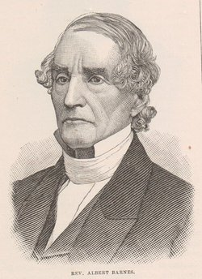
Peace of God Rules in Hearts
The word here rendered rule—βραβευετω—is commonly used in reference to the Olympic and other games. It means, to be a director, or arbiter of the public games; to preside over them and preserve order, and to distribute the prizes to the victors. The meaning here is, that the peace which God gives to the soul is to be to us what the brabeutes, or governor at the games was to those who contended there. It is to preside over and govern the mind; to preserve every thing in its place; and to save it from tumult, disorder, and irregularity. The thought is a very beautiful one. The soul is liable to the agitations of passion and excitement—like an assembled multitude of men. It needs something to preside over it, and keep its various faculties in place and order; and nothing is so well
Barnes

Slide 22
fitted to do this as the calm peace which religion gives, a deep sense of the presence of God, the desire and the evidence of his friendship, the hope of his favour, and the belief that he has forgiven all our sins. The “peace of God” will thus calm down every agitated element of the soul; subdue the tumult of passion, and preserve the mind in healthful action and order—as a ruler sways and controls the passions of assembled multitudes of men.
.
Albert Barnes, Notes on the New Testament: Ephesians, Philippians & Colossians. (pp. 278–279).
Barnes
Which
Is
It?
Peace of God
Controlling
Thoughts / Passions
Thoughts / Passions
Destroying
Any Peace

Slide 23
Manifestations of the Peace of God
Let Peace Rule our hearts (Col. 3:15)
Turn Worry & Anxiety to God (Phil. 4:6-7; 1 Pet. 5:7)
Trust in God (Heb. 13:20)
Content (Phil. 4:11)
Spiritually Minded (Rom. 8:6)
Strive for Unity (Eph 4:1-3)
Should
Live in Peace (2 Cor. 13:11)

Slide 24
The Peace of God
The Peace of God
What is the Peace of God?
Those Who Have the Peace of God
Those that Don’t Have the Peace of God
Directions of the Peace of God
Manifestations of the Peace of God

